Slide 1

ATAL BIHARI VAJPAYEE - INDIAN INSTITUTE OF INFORMATION TECHNOLOGY AND MANAGEMENT GWALIOR
Mini project on ‘‘GWALIOR MELA’’ under Supervision of
DR. ARUN KUMAR
DR. SOMESH KUMAR

Slide 2
Mini-Project Report on Gwalior Mela Date - 23 April 2020 - Himanshi Kalra (2017IMG-024) - Ilapanda Abhilash (2017IMG-026) - Jayesh Kamble (2017IMG-027) - Akash Aditya (2017IMG-029) - Kumar Shashwat (2017IMG-030)

Slide 3
Gwalior Trade Fair:
A Century-Old Business Marvel

Slide 4
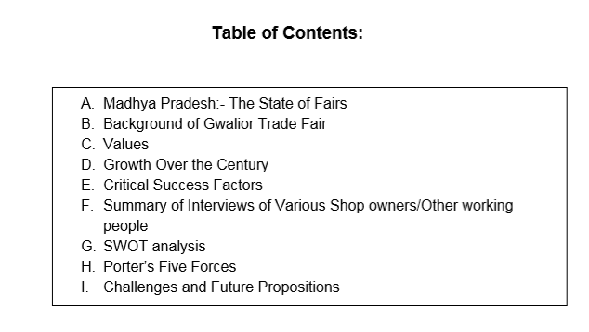

Slide 5
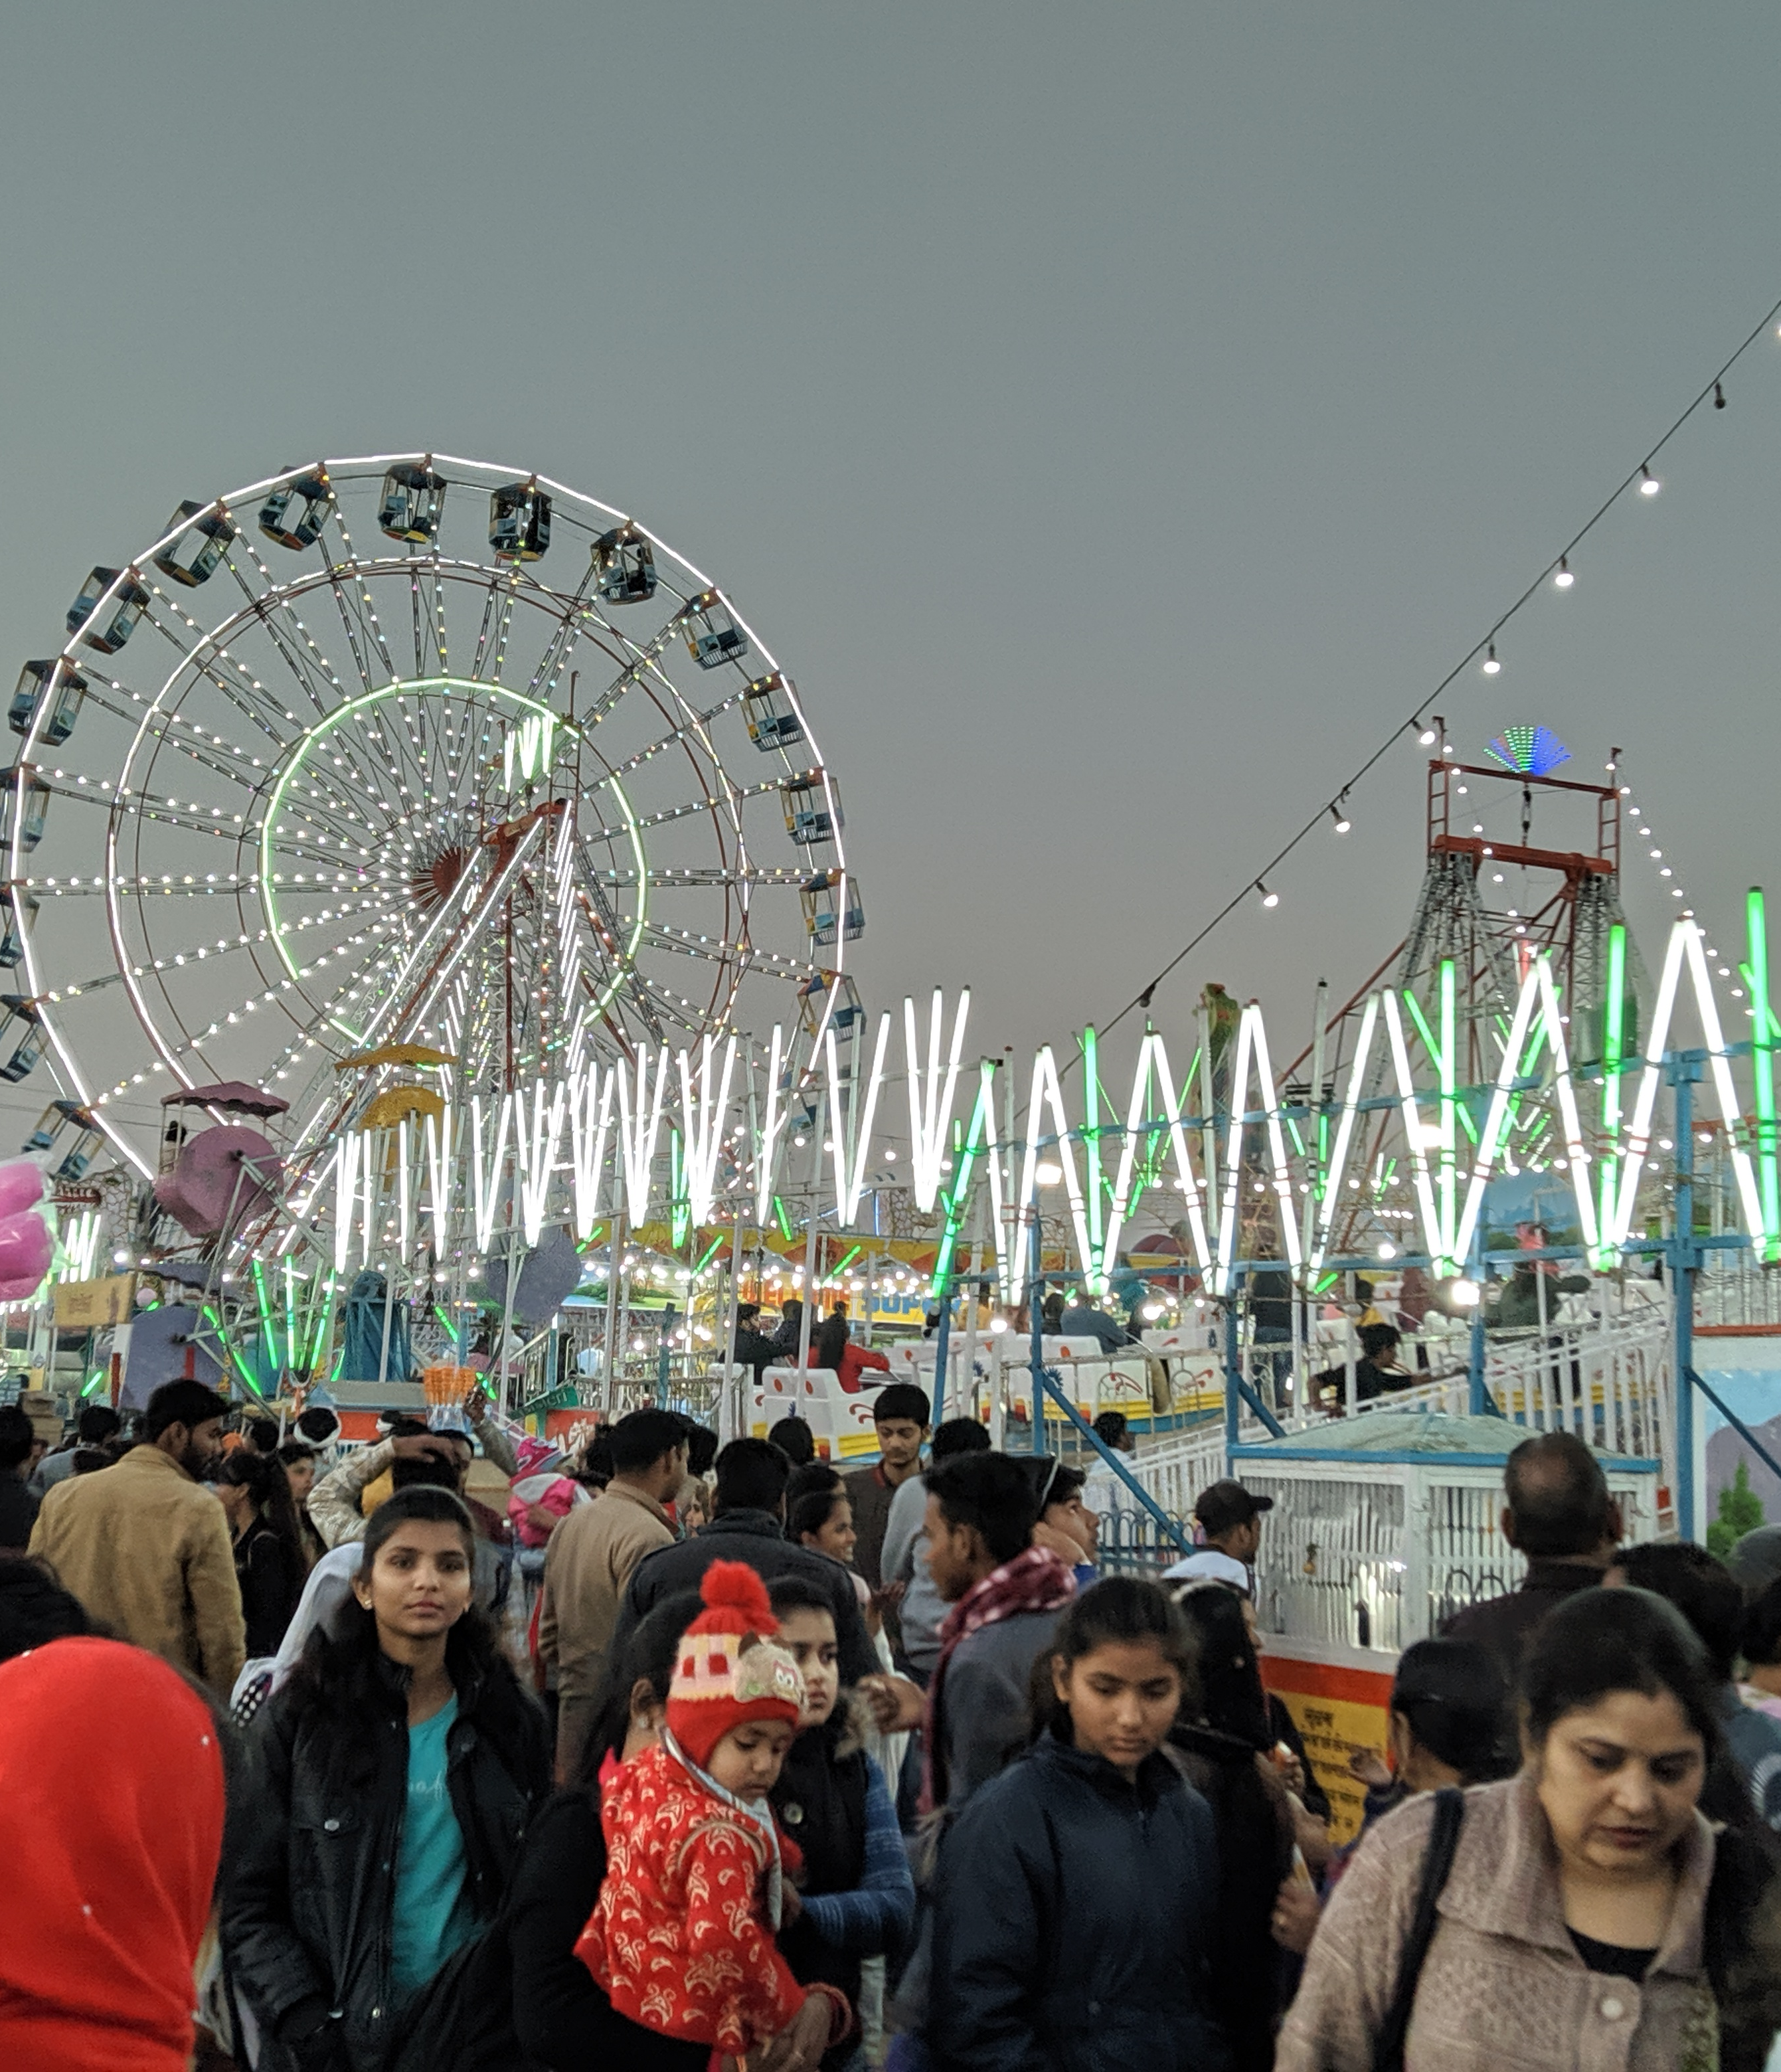
A. Madhya Pradesh: The state of Fairs
Fairs are a coming together of people of various backgrounds. It is a harmonic procession of happiness and joy.
Madhya Pradesh has a rich legacy of fairs, expanding from ​Malwa to Mahoba, from Datia to Chhattisgarh, from Orchha to Bastar.
Not only do these capture the intermingling fragrance of diversities, but also provide a source of livelihood to many. The fairs act as a backbone of Madhya Pradesh’s socio-economic culture.
It’s significance can be imagined by the fact that many call it to be "​The Koh-i-Noor of India's Mela Culture​".

Slide 6
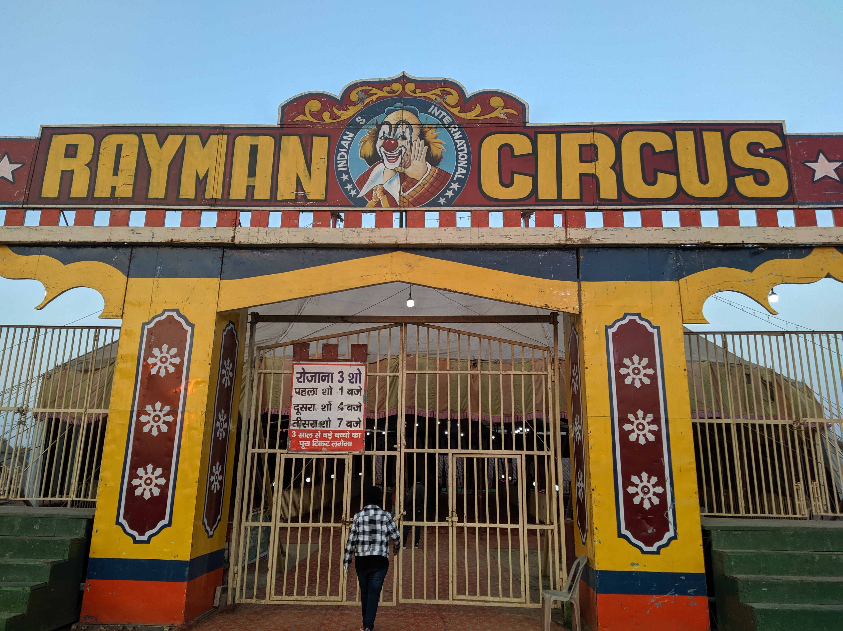
B. Background of Gwalior Trade Fair
First started in 1905, the Gwalior trade fair is already more than a century old.
It was started by Maharaj Madhav Rao Scindia.
Initially Started as a Cattle Trade Fair.
Currently Asia’s largest Trade Fair.
More than ​50 Lakh people visit the Mela ​annually.
What makes it a speciality is that only a few fairs can even come close to the variety and vastness of the ‘Gwalior Mela’.

Slide 7
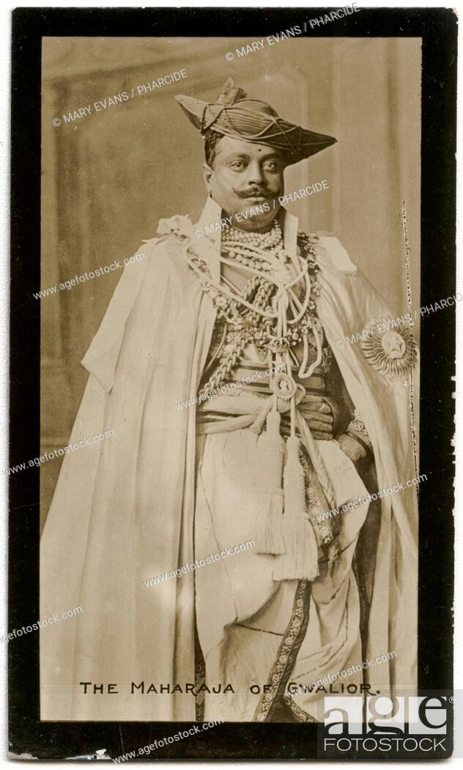
C. VALUES
Gwalior Mela started in 1905 because of then ruler, Madhav Rao Scindia. (fig. in the right)
Gwalior Mela soon became an example of how problems can be tackled and something beautiful can come out of the collective will power of masses.
Despite how the changing times kept most of the rulers preoccupied and perplexed, Highness Madhav Rao anticipated how starting this tradition would go beyond all the current problems. Amidst confusion and chaos and the rise and fall of rulers, he did something that rarely allowed other rulers to even consider.

Slide 8
D. Growth over the Country
"Mela Maveshiaan", the name of the Mela when it originally started, began due to natural calamities hitting Gwalior twice in the same decade, once in 1894 and then again in 1904. They had a grave impact on farmers as they left families starving.
Hence, Mela Maveshiaan was started to help farmers by providing them a chance to bargain with farmers of other states to get competitive prices for their produce.
Apart from the customers who come to enjoy the mela by going on rides, shopping, or grabbing a snack on food stools, the Mela is also a center for traders.
After Maharaja Madho Rao, Maharaja Jiwaji Rao Scindia and later Mr. Madhav Rao Scindia greatly helped in developing Gwalior Mela to the scale and vastness of what it is today.
Over the years, the administration rights of the Mela went to a committee of businessmen and people who were nominated.
Not just the artists of Gwalior, but from regions beyond the boundaries of Madhya Pradesh come to display their talents. But the Fair is not just a means of getting exposure and quenching creative thirst, as the business is a means to approximately an income of ₹60 lakh.

Slide 9
E. Critical Success Factors
Exemption of Sales Tax gave a major boost to Gwalior Trade Fair by making it a very attractive place to trade in. Not only does it help the sellers in increasing their margins, but it helps the middle class people who have limited budgets for their dreams.
Another sector which got hugely benefited from these exemptions is the automobile sector. Tax cuts brought down the prices of vehicles like tractors, motorcycles, scooters, three and four-wheelers.
Welcome to wonderland, we’ve got it all - From ‘Kushti’ to ‘Kavi Sammelan’, from ‘Lehengas’ to ‘Chanderi’ sarees, from Agra’s famous ‘Pethe’ to Gwalior’s own speciality ‘Gazak’, From ‘Mathura ke Pede’ to ‘Bihar ke Khaze’, from Kashmiri shawls to Radhasthani ‘Chundaris’, from international circus to juggler’s shows, from ‘Kavvalis’ to Padmini’s dance, from pincers to lawn mowers, from electronic exhibitions to book stalls.
Our rich heritage of handicrafts is also laid out in the emporia called ‘Shilp Bazar’, which consists of about 63 permanent pucca shops for the craftsmen participating from all over India.

Slide 10
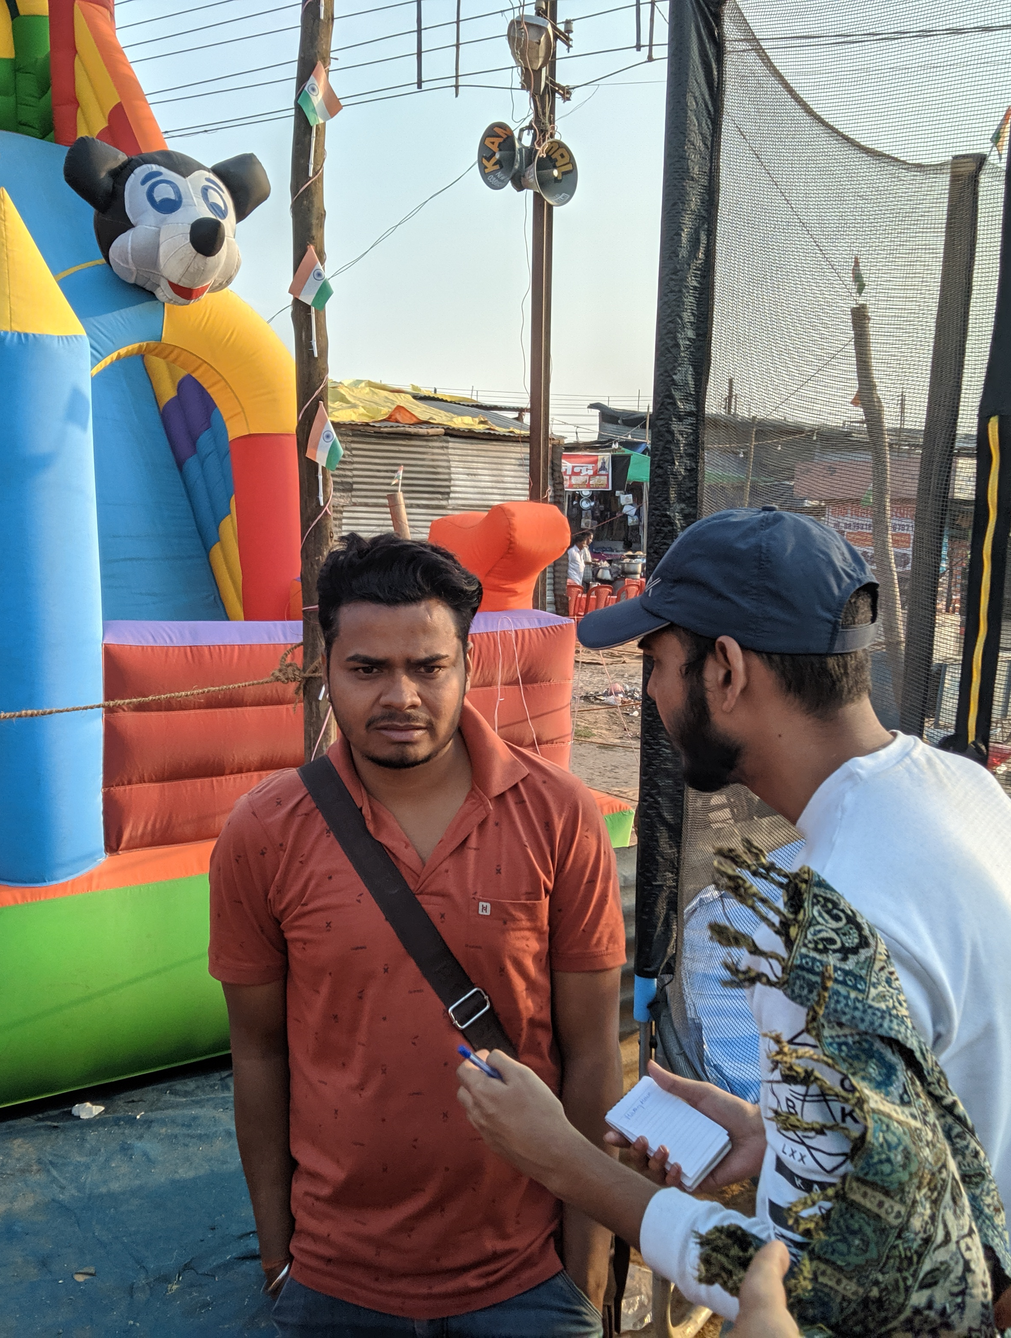
F. Summary of Interviews of Various Shop owners/Other working people
Mickey Mouse Air Balloon Shop Owners - They pay a rent of about Rs18,000 to Rs40,000 depending on the space they have acquired, their total earnings amount to Rs60,000 to Rs 80,000.
Giant Wheel Owners -The ‘highest’ ROI amongst all the categories of stalls/rides interviewed was of ‘Giant Wheel’ owners. A few refused to disclose their daily or average sales, but the ones who agreed to give an estimate said that the overall earnings are close to 8-10 Lakhs. Typically managed by a staff of 10, the individuals easily earn over 75k in profits every mela season.
Coca Cola / Pizza Hut Stores -Mainly promotional and advertising purposes .
Small Food Stalls -Their rent is very small compared to shop and ride owners, typically in the range of 5-10k.

Slide 11
G. SWOT analysis
Strengths
● Famous
● Organized over a huge area to exposure to many people
● Source of livelihood for vendors and handicrafts (wo)man.
● Source of enjoyment for children and grownups.
Weakness
● Certain aspects are unplanned (like waste disposal management)
● Too much dust arises from rides as the ground is covered with sand.
● Parking can be a major issue (along with traffic management).

Slide 12
Opportunities
● Can improve internal transportation by collaborating with e-vehicles.
● Can do better crowd management by giving some incentives on weekdays (as crowds come more on weekends).
● Ensuring basic standards of food quality are being maintained.
● Distancing rides and food stalls as rides lead to dust.
Threats
● Too many lethal accidents on or near rides can make people afraid.
● Too many cases of food poisoning.
● Frequent concerts/ programs/rallies are being organized in the same locality.
● Better quality street food is available just outside the mela.

Slide 13
H. Porter’s Five Forces Analysis:
A. Threat of new entrants:
Due to Governmental aid and its sheer size, Gwalior trade fair enjoys a monopoly over other trade fairs in the region.
However, its proximity to the prosperous and heavily invested Delhi-NCR region may result in the emergence of a competitor.
B. Threat of Substitutes
1. Shopping Malls offer more competitive prices and better customer service and a few malls have opened up in the city in recent years.
2. People in rural areas are getting acquainted with online shopping.
C. Bargaining power of customers
1. People often buy late during the trade fair when sellers sell at a lowered price as they are forced to clear the inventory.
2. There are a lot of shops selling similar stuff, so it’s essentially a buyer’s market.

Slide 14
D. Bargaining power of suppliers
Suppliers often focus on clearing off their stock of underselling items or the ones in low demand.
Some customers may sense this and may create a low-cost low-value perception of the goods sold here.
E. Competitive rivalry
There are other trade fairs in nearby regions like Shilp Trade Fair and Taj Mahotsav.
However, most of these trade fairs are much smaller or focus on niche-products unlike Gwalior trade fair. (Shilp Mela chiefly focusses on Craft-items.)

Slide 15
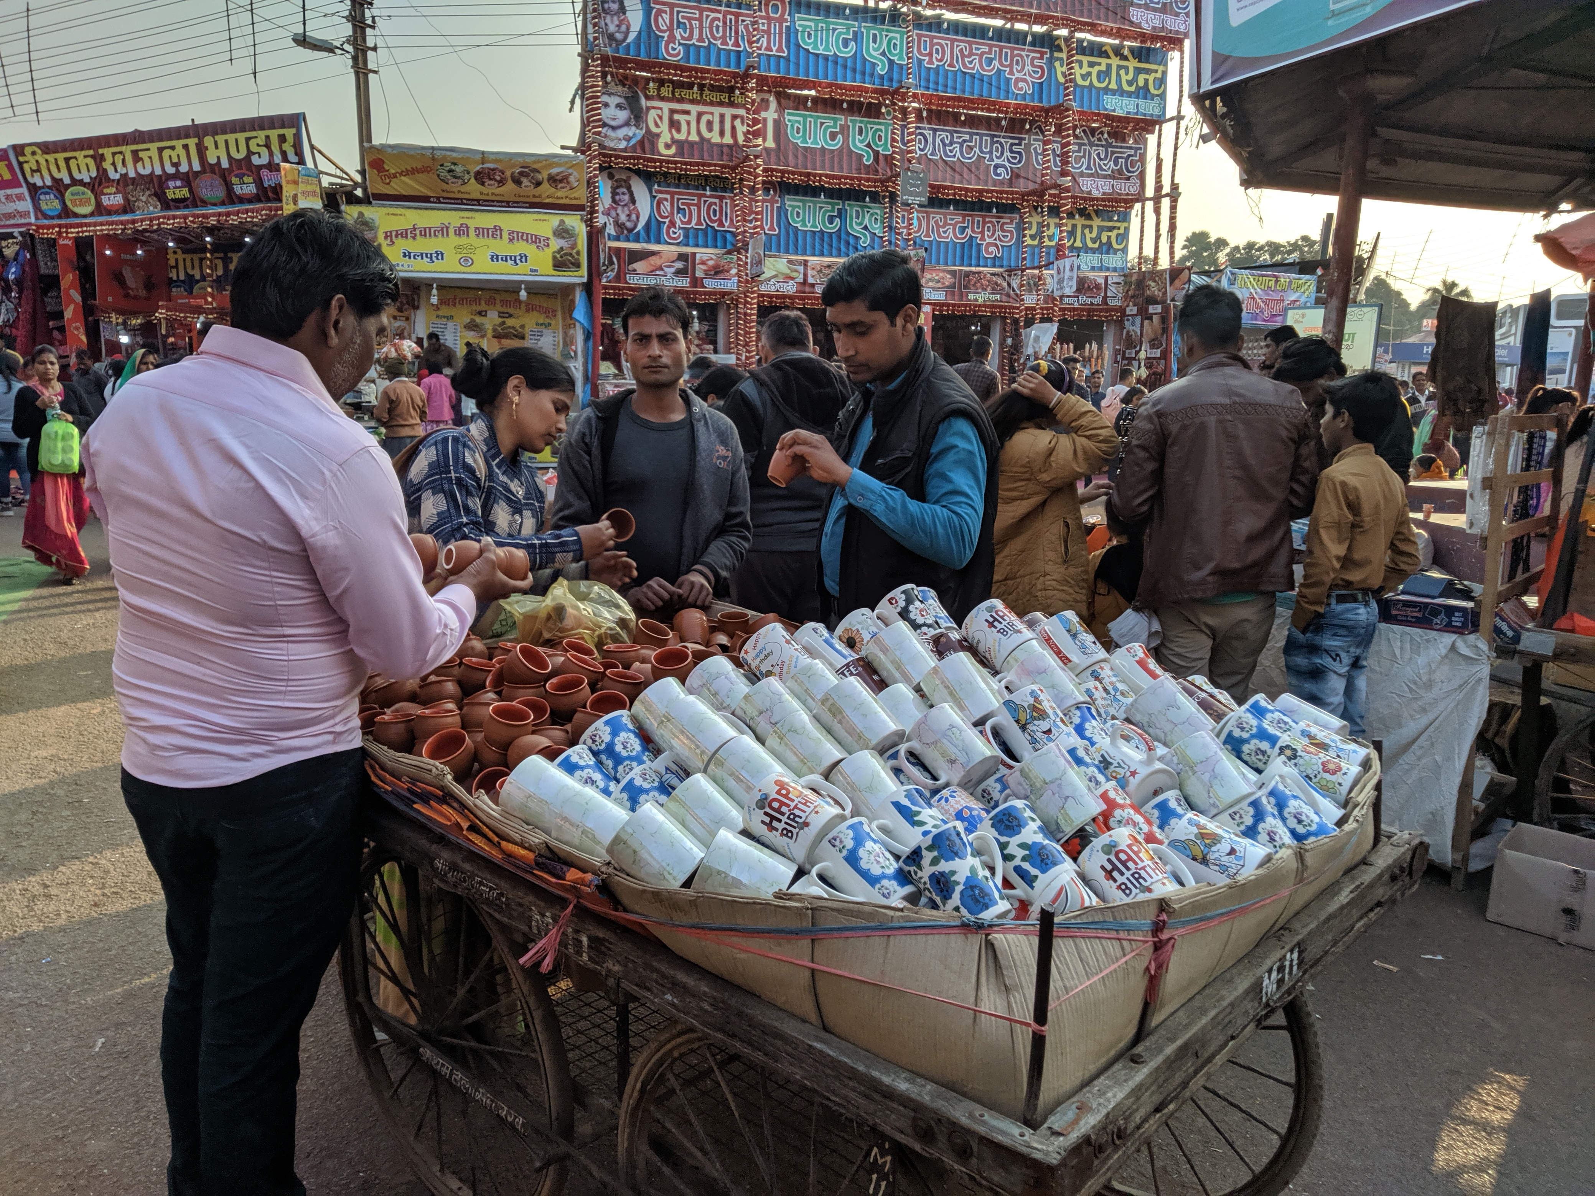
I. Challenges and Future propositions
Challenges
● People buying shop ‘spots’ early at low prices and later selling them at very high prices.
● Current challenges like the pandemic corona-virus will badly affect the Gwalior Mela, as people will be scared and conscious as well.
● Competing melas in nearby states.
● People buying stuff towards the end of the Mela to get cheap prices as the prices are reduced to more than half as sellers try to recover as much revenue as possible selling in losses even to clear their inventory.

Slide 16
Future Propositions
● E-selling of shops for more equality, leaving out the mediator.
● As noted above, certain big merchants buy many spots for shops in bulk as soon as the allotment starts and later sell them at very high prices to the actual vendors who set up shop.
● If this entire process is digitalised, it will curb this ill practise by making the process transparent.
● A source who doesn’t want themselves to be revealed said that the actual price of shops was as low as 3k-5k.
● Still a form of recreation.
● A form of income for the people of rural areas
References:
http://www.mptfa.com/tender/gtfNote.pdf
http://code.mp.gov.in/WriteReadData/Pdf/Act_1996_0022_Pdf_F11_Englis h.pdf

Slide 17
"I saw life Steadily and saw it whole“.
Matthew Arnold(English poet) about Gwalior Mela

Slide 18
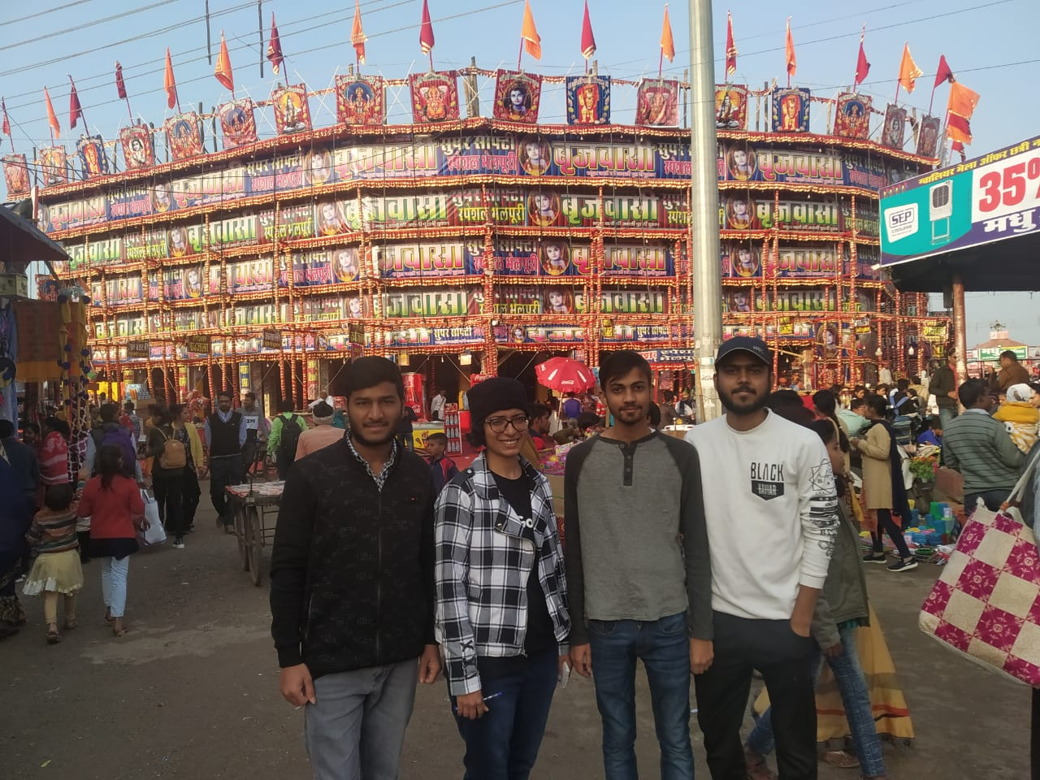
THANK YOU

